Slide 1

Red Star Alliance

Slide 2
Ship Breakdown
Ships, Types, Bonuses, Exclusives that fit, and ideal uses

Slide 3
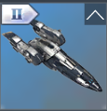
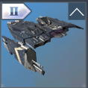
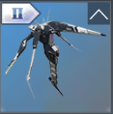

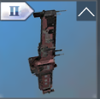
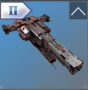
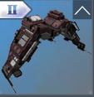
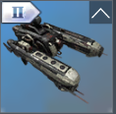
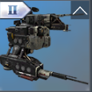
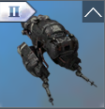
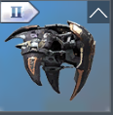
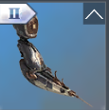
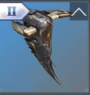
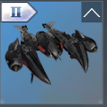
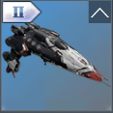
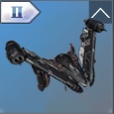
Frigates
Smallest ship type
Uses S Single weapons
Ideal for providing buffs and debuffs
Die easily (lowest resistances)

Slide 4
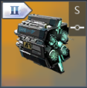
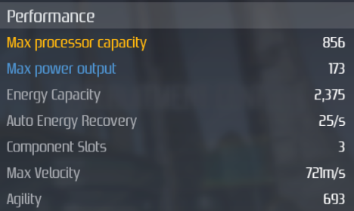
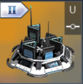
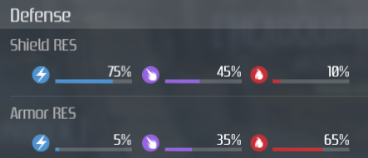
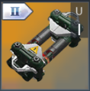

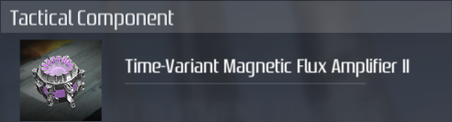
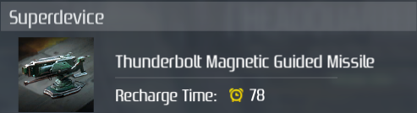
Mist/Sprinkle/Shower
Exclusive Devices Available
Scout
Faction
Basic Bonuses
ECD
Blaster CD Reduc
Inertia Factor Reduc
Thruster Boost
Type
Strike/Scout
Special Bonuses
Mods
Warp Max Velocity Boost
Cloaking Activation Cost Reduc
Cloaking Activation Delay Reduc
Exclusive Components Available
Fallen Star (12.5%)
Ideal Use
Scouting
DMG increases as enemy energy decreases
Guided missile that deals EM dmg to all targets within 14km of explosion
Slows enemy targets
Higher dmg done on large ships (BC & BS)

